Slide 1
ppt

Slide 2
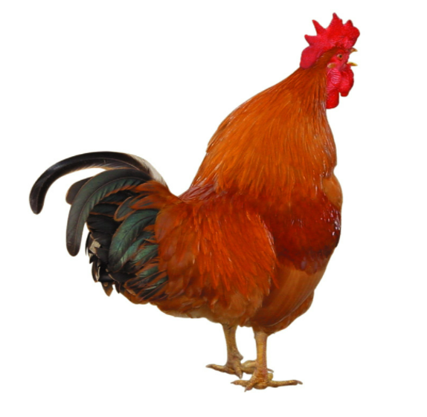

Slide 3
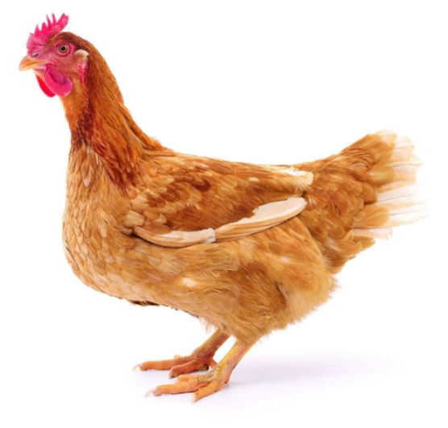

Slide 4


Slide 5
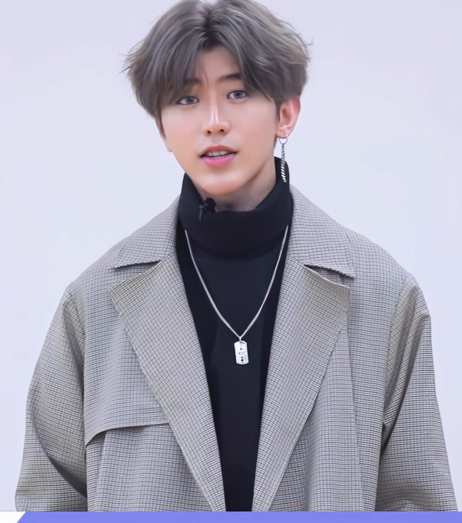

Slide 6
蔡徐坤
中国内地男歌手、演员、原创音乐制作人

Slide 7

1998年8月2日出生于浙江省温州市，户籍湖南吉首 ，中国内地男歌手、演员、原创音乐制作人、MV导演
KUN, born in Wenzhou, Zhejiang Province on August 2, 1998, with household registration in Jishou, Hunan Province, is a male singer, actor, original music producer and MV director in mainland China

Slide 8

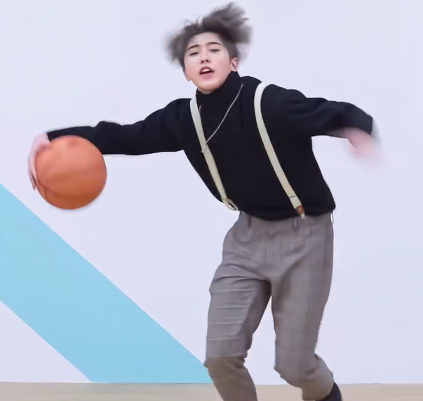
2018年1月，参加竞演类综艺节目《偶像练习生》并以总票数第一正式出道
In January 2018, he took part in the competition variety show Idol Producer and made his debut with the first place in total votes

Slide 9
蔡徐坤作为内娱选秀天花板，出道多年一直在艺术领域不懈追求，凭借独特的音乐理解力和超强的创作能力游走于中西流行音乐之间，从而成就了《只因你太美》特有的前沿曲风。
kun, as the ceiling of the internal entertainment talent show, has been making unremitting pursuit in the field of art for many years, with unique music understanding and super creative ability to walk between Chinese and Western popular music, thus achieving the unique frontier music style of "Because you are too beautiful".

Slide 10
Thanks

